Slide 1
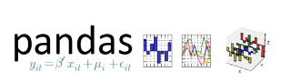
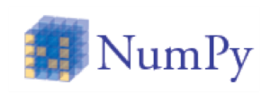



Project Diagram and Structure
Order of operations
ML Iterations
Raw Data csv
Wrangling Module Pandas Python
Exploratory Data Analysis Numpy & matplotlib
Machine Learning Scikit-learn
Final Model Spec
Scikit-learn
Qlik Sense
Presentation
1
2
3
4
5
6
Read the raw data into Python
Check the variable format, min/mean/medium/max/std dev, and missing values.
Understand the relationship among dependent and explanatory variables
Explore machine learning techniques
Final model will be run on previous model specifications
Present final result
For details in each step, please refer to the next slide.

Slide 2
Pet Adoption Project Processing Flow
The data set used in our project is a model ready data, and doesn’t need to merge with additional data sets. Therefore, our project starts with reading in the data into Python (step 1) and conduct data wrangling (step 2).
Step 1: Read the raw data into Python
Step 2 – Data wrangling: includes check the variable format, min/mean/medium/max/std dev, and missing values. If the variable format is incorrect, the format will be corrected. If there are abnormal min or max observed, flooring/capping would be considered. If missing values are observed, missing replacement will be considered based on the missing pattern, e.g. replacing by mean, medium, or imputation.
Step 3 – Exploratory Data Analysis: to understand the relationship among dependent and explanatory variables, including correlation matrix, 2x2 tables, scatter plots, principal component analysis, etc. The key analysis results will be presented in data visualization.
Step 4 – Machine Learning Modeling: based on the information learnt from step 3, appropriate machine learning model techniques will be explored, e.g. random forest, GMB, etc. This step will be re-iterated based on the model specification and performance from each step to fine tune the model specifications.
Step 5 – After using the machine learning models to search the final model specifications, the model specification will be run through logistic regression to gain the coefficients on all the significant explanatory variables for better interpretation and business justification
Step 6 – Presentation: present the final results

